Slide 1
K-Nearest Neighbors (K-NN)

Slide 2
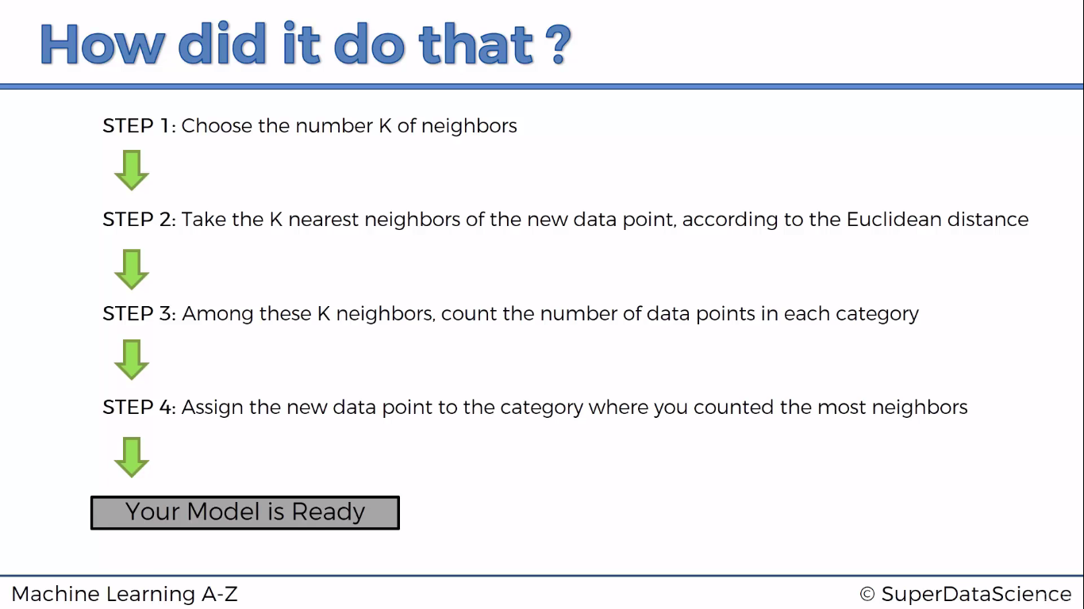

Slide 3
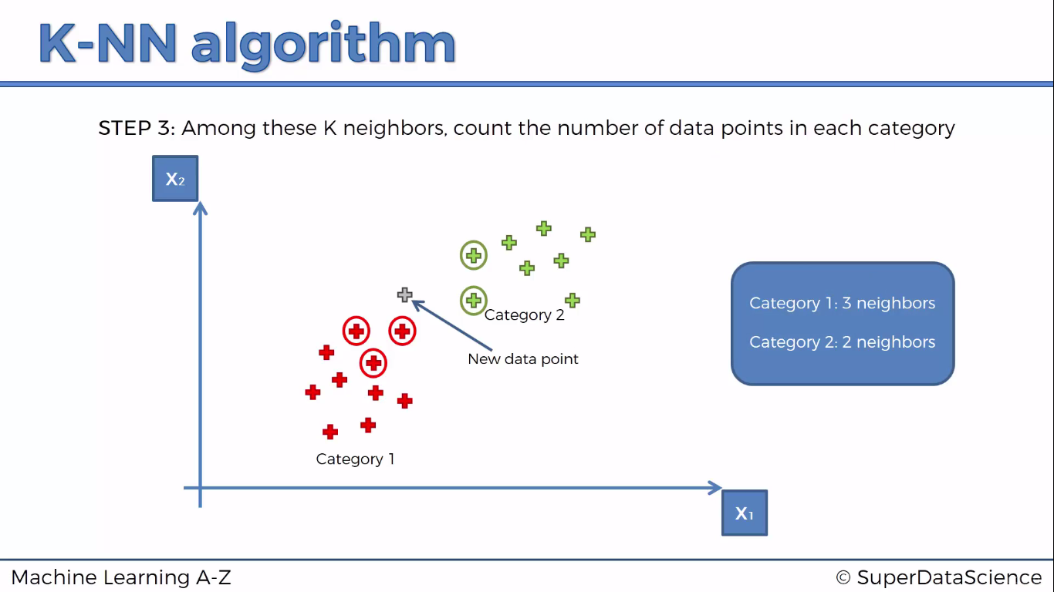

Slide 4

Python

Slide 5
Reading dataset dynamically
from tkinter import *
from tkinter.filedialog import askopenfilename
root = Tk()
root.withdraw()
root.update()
file_path = askopenfilename()
root.destroy()

Slide 6
Importing Libraries
import pandas as pd
import numpy as np
import matplotlib.pyplot as plt

Slide 7
Importing dataset
dataset = pd.read_csv('Social_Network_Ads.csv')
X = dataset.iloc[:,2:4]
y= dataset.iloc[:,-1]

Slide 8
Splitting the dataset into the Training set and Test set
from sklearn.cross_validation import train_test_split
X_train, X_test, y_train, y_test = train_test_split(X, y, test_size = 0.25, random_state = 0)

Slide 9
Feature Scaling
from sklearn.preprocessing import StandardScaler
sc = StandardScaler()
X_train = sc.fit_transform(X_train)
X_test = sc.transform(X_test)

Slide 10
Feature Selection …
Recursive Feature Elimination (RFE) is based on the idea to repeatedly construct a model and choose either the best or worst performing feature, setting the feature aside and then repeating the process with the rest of the features.
This process is applied until all features in the dataset are exhausted. The goal of RFE is to select features.

Slide 11
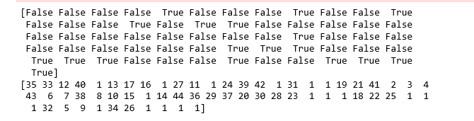
Feature Selection …
from sklearn import datasets
from sklearn.feature_selection import RFE
from sklearn.linear_model import LogisticRegression
logreg = LogisticRegression()
rfe = RFE(logreg, 2)
rfe = rfe.fit(X, y )
print(rfe.support_)

Slide 12
Fitting classifier to the Training set
from sklearn.neighbors import KNeighborsClassifier
classifier = KNeighborsClassifier(n_neighbors=5,metric='minkowski',p=2)
classifier.fit(X_train,y_train)

Slide 13
Confusion Matrix
from sklearn.metrics import confusion_matrix
cm = confusion_matrix(y_test, y_pred)

Slide 14
K fold
from sklearn import model_selection
from sklearn.model_selection import cross_val_score
kfold = model_selection.KFold(n_splits=10, random_state=7)
modelCV = KNeighborsClassifier()
scoring = 'accuracy'
results = model_selection.cross_val_score(modelCV, X_train, y_train, cv=kfold, scoring=scoring)
print("10-fold cross validation average accuracy: %.3f" % (results.mean()))

Slide 15
Prediction
y_pred = classifier.predict(X_test)

Slide 16
Evaluating classification report
from sklearn.metrics import classification_report
print(classification_report(y_test, y_pred))

Slide 17

R

Slide 18
Read dataset
library(readr)
dataset <- read_csv("D:/machine learning AZ/Machine Learning A-Z Template Folder/Part 3 - Classification/Section 14 - Logistic Regression/Logistic_Regression/Social_Network_Ads.csv")
dataset = dataset[3:5]

Slide 19
Encoding the target feature as factor
dataset$Purchased = factor(dataset$Purchased, levels = c(0, 1))

Slide 20
Splitting the dataset into the Training set and Test set
# install.packages('caTools')
library(caTools)
set.seed(123)
split = sample.split(dataset$Purchased, SplitRatio = 0.75)
training_set = subset(dataset, split == TRUE)
test_set = subset(dataset, split == FALSE)

Slide 21
Feature scaling
training_set[-3] = scale(training_set[-3])
test_set[-3] = scale(test_set[-3])

Slide 22
Fitting K-NN to the Training set & prediction
library(class)
y_pred = knn(train = training_set[, c(1,2)],
test = test_set[, c(1,2)],
cl = training_set$Purchased,
k = 5,
prob = TRUE)

Slide 23
Confusion matrix
cm = table(test_set[, 3], y_pred)

